Slide 1
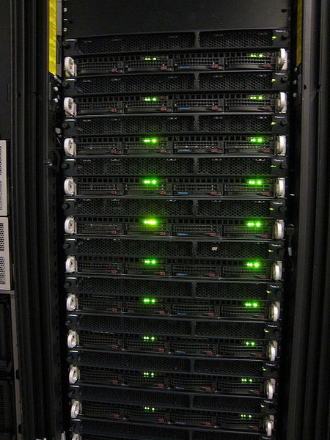

A Brief Introduction To the Orion Cluster
Runar Helin
DAT300, NMBU
07.10.2021
Notes:
After watching this lecture you should be able to set up and submit a job on the Orion cluster.
- This lecture goes through the steps necessary for the students taking DAT300 to complete the second compulsory assignment.

Slide 2
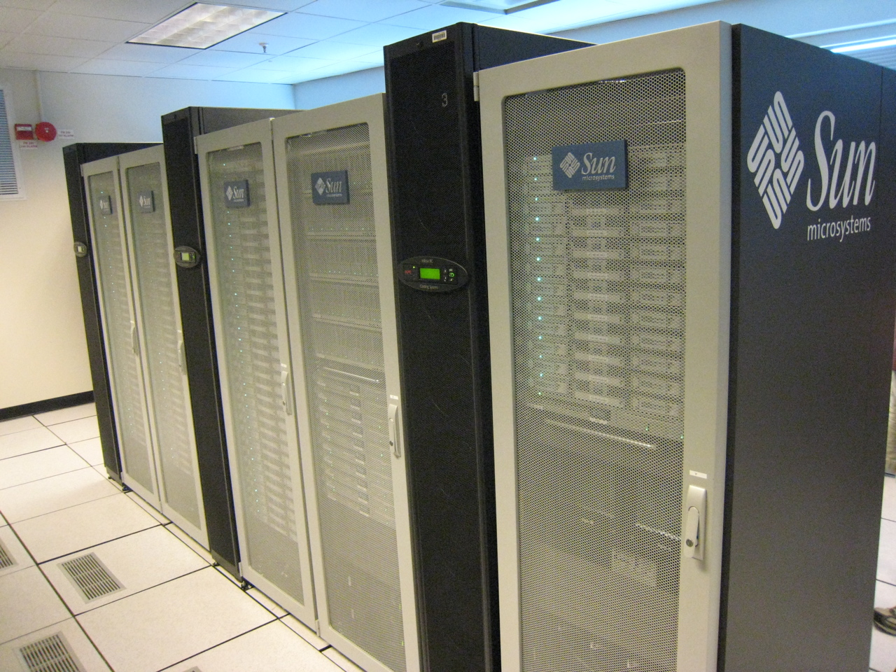



The first half of the lecture will show the main elements of using the NMBU Orion cluster
Overview
Get access to Orion, and transfer files
Basic Linux commands
Notes:
First part of the lecture

Slide 3



The second half walk you through an example of how to submit a job on Orion
Overview
Get access to Orion, and transfer files
Basic Linux commands
Notes:
Second part of the lecture walks you through an example

Slide 4
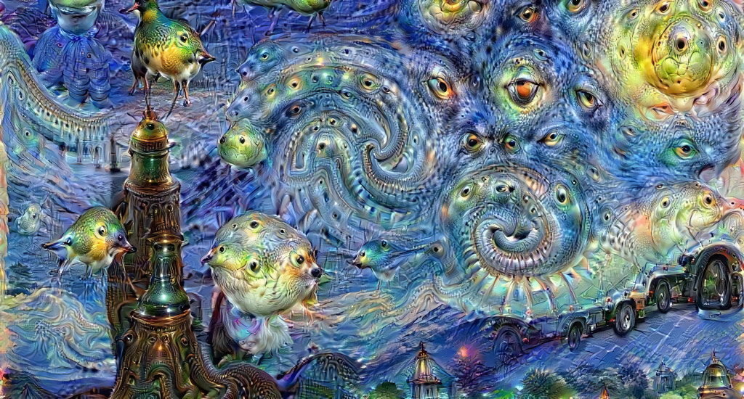
More information about the cluster can be find in the official documentation
Orion documentation
https://nmbu-orion-support.readthedocs.io/en/latest/index.html
Notes:
The focus of this talk is to introduce the DAT300 students for the necessary tools
We will focus on the use of the GPU
- For more details about Orion and possibilities using CPUs, have a look at the homepage.

Slide 5
Orion is a computer cluster capable of handling small-scale projects
Hosted by NMBU and operated by CIGENE and the NMBU IT department.
Notes:
Collection of CPUs and GPUs
Can run jobs requiring more memory than laptops
Use more cores
Speed up computer intensive jobs

Slide 6
The cluster is divided into different partitions, suitable for different jobs
verysmallmem
smallmem
hugemem
gpu
For the second compulsory assignment in DAT300 we will only use the gpu partition
Notes:
The user can specify which partition to run the jobs on
Different partitions have different specs and can handle different memory requirements
For DAT300 only the gpu partion. Reason: Only running neural networks which are optimized to run on gpu.
4 GPU processors each with 3 cores.

Slide 7
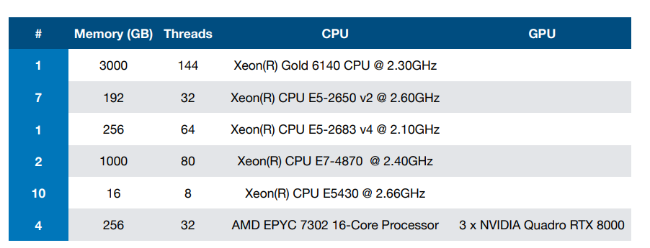
The cluster consists of different types of hardware

Slide 8
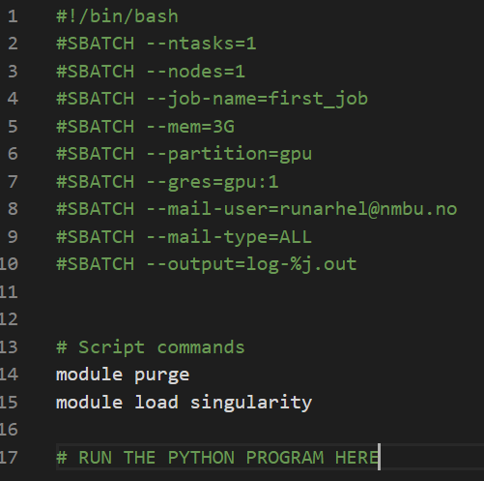
To submit jobs to the cluster you need to write SLURM-scripts
SLURM commands
sbatch job_script.sh
squeue –u username
scancel <job_id>
Notes:
- Slurm will distribute your jobs to the correct partition and handles the queues
Specify settings at the top of the document as shown
Load modules
Write a line to execute the python program in the SLURM script

Slide 9
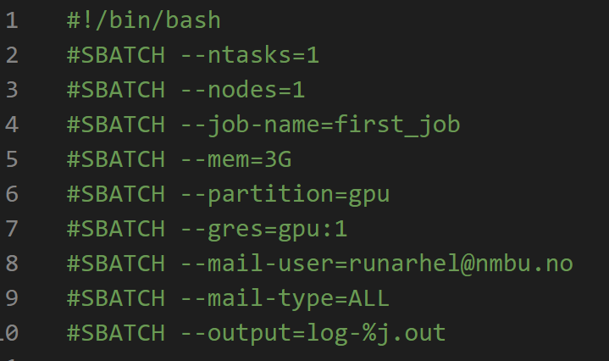
The slurm variables must be defined for each job
Notes:
Details about each sbatch argument.

Slide 10
The slurm variables must be defined for each job
Number of CPUs
Notes:
Details about each sbatch argument.

Slide 11
The slurm variables must be defined for each job
Number of computer nodes
Notes:
Details about each sbatch argument.

Slide 12
The slurm variables must be defined for each job
Name of job
Notes:
Details about each sbatch argument.

Slide 13
The slurm variables must be defined for each job
Maximum memory consumption
Notes:
Details about each sbatch argument.

Slide 14
The slurm variables must be defined for each job
Partition to use
Notes:
Details about each sbatch argument.

Slide 15
The slurm variables must be defined for each job
Number of GPU cores to use
Notes:
Details about each sbatch argument.

Slide 16
The slurm variables must be defined for each job
Notes:
Details about each sbatch argument.

Slide 17
The slurm variables must be defined for each job
Receive all notifications
Notes:
Details about each sbatch argument.

Slide 18
The slurm variables must be defined for each job
Output file name
Notes:
Details about each sbatch argument.

Slide 19

Please be mindful of the resources.
Notes:
Don't ask for more resources than your job need.
Don't waste resources
Share the resources with the other users

Slide 20
In this course, we will only use a single GPU core per job!
Notes:
- Limit the memory-requirements and don't run very long jobs.

Slide 21

You will have your home directory on the cluster, but jobs are faster to run on another location
$HOME
$TMPDIR
Notes:
On orion you log on to your Home directory. The jobs are run on separate nodes not directly connected to your home directory.
Reading and saving files between the computer node and home directory is slow.
ALWAYS run jobs on the computer node by using the sbatch command.

Slide 22
To navigate through your file system, you need to use Linux commands
ls
rm
cd
mkdir
cp
pwd
Consult the internet for more details and more commands
Notes:
Some of the basics Linux commands we might need during the course.
In addition we use rmdir that removes an empty directory.

Slide 23
To navigate through your file system, you need to use Linux commands
List files and folders at current location
ls
rm
cd
mkdir
cp
pwd
Consult the internet for more details and more commands

Slide 24
To navigate through your file system, you need to use Linux commands
ls
rm
cd
mkdir
cp
pwd
Remove file
Consult the internet for more details and more commands

Slide 25
To navigate through your file system, you need to use Linux commands
ls
rm
cd
mkdir
cp
pwd
Change directory
Consult the internet for more details and more commands

Slide 26
To navigate through your file system, you need to use Linux commands
ls
rm
cd
mkdir
cp
pwd
Make new directory
Consult the internet for more details and more commands

Slide 27
To navigate through your file system, you need to use Linux commands
ls
rm
cd
mkdir
cp
pwd
Copy file or directory
Consult the internet for more details and more commands

Slide 28
To navigate through your file system, you need to use Linux commands
ls
rm
cd
mkdir
cp
pwd
Print current directory
Consult the internet for more details and more commands

Slide 29
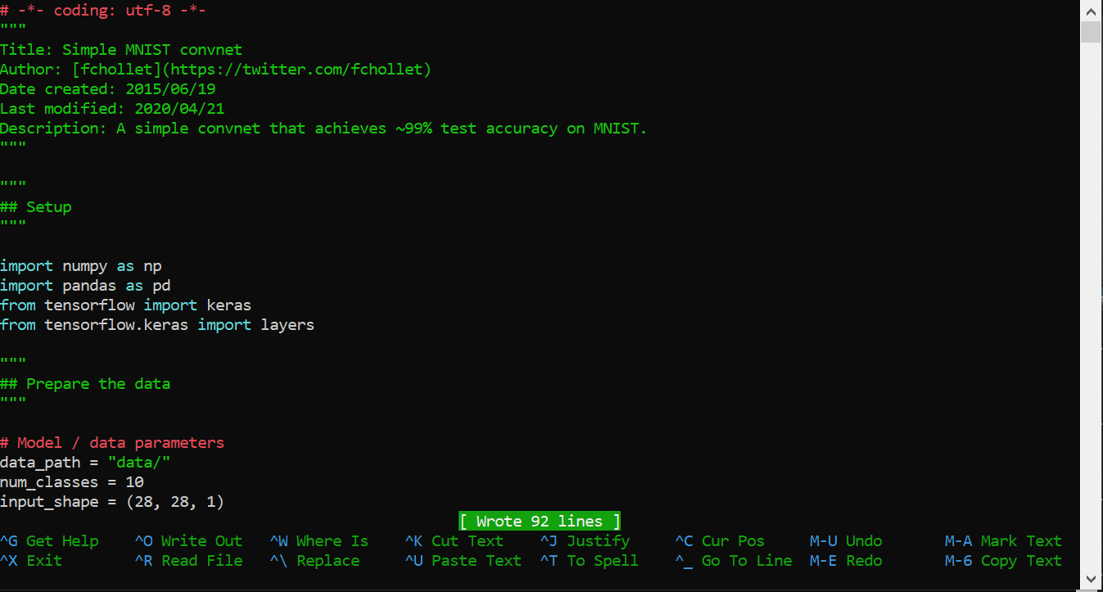
You can edit scripts on Orion using the text-editor NANO
Notes:
- If you need to make changes to your scripts, you can use the text-editor NANO
I recommend making changes on your local computer and upload that to Orion.

Slide 30
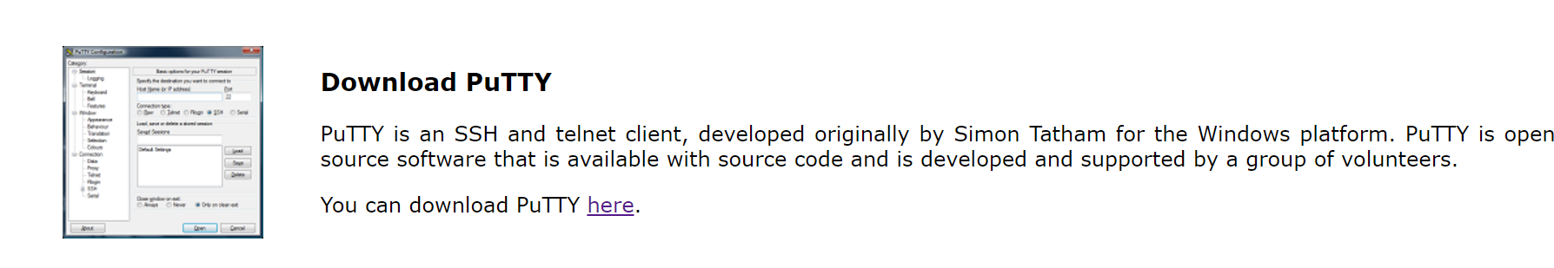
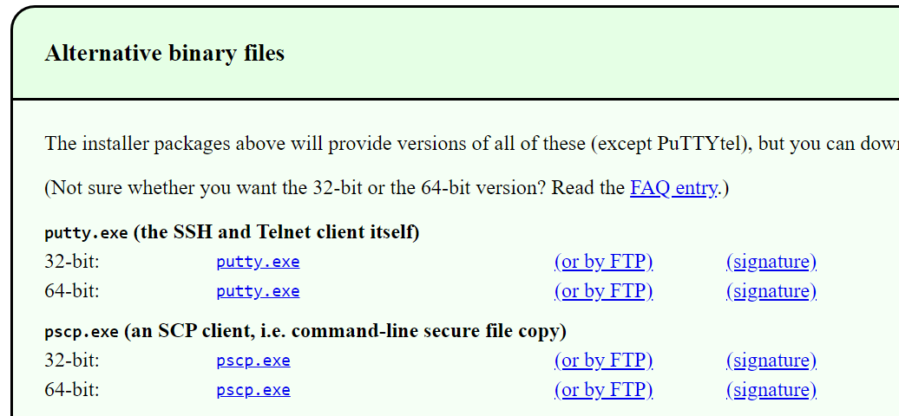
To transfer files between your computer and Orion we can use the program PuTTY on Windows
https://www.putty.org/
Notes:
Windows users need an ssh client to log on to Orion.

Slide 31
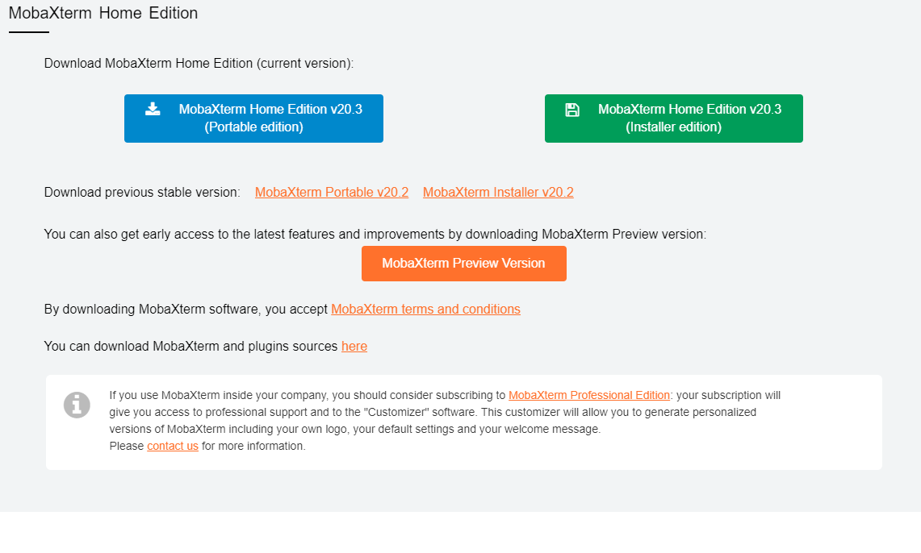
MobaXterm is an alternative to PuTTY (for Windows users only)
Download the MobaXterm software here:
https://mobaxterm.mobatek.net/download-home-edition.html
Direct download link https://download.mobatek.net/2032020060430358/MobaXterm_Portable_v20.3.zip
31

Slide 32
To transfer files using PSCP run the following command
pscp
Transfer file to Orion
pscp
The Orion host name has changed to login.orion.nmbu.no
Transfer file from Orion
pscp
Mac and Linux users use the command scp instead of pscp.
Notes:
General commands to transfer files between your computer and Orion.

Slide 33
Mac and Linux users have an SSH client already installed
Log on to Orion
ssh <username>@login.orion.nmbu.no
Change <username> to your actual Orion username
Notes:
You need to be on the NMBU network for this to work.
- Set up a VPN for NMBU by using the IT-documentation if you are not at the campus

Slide 34
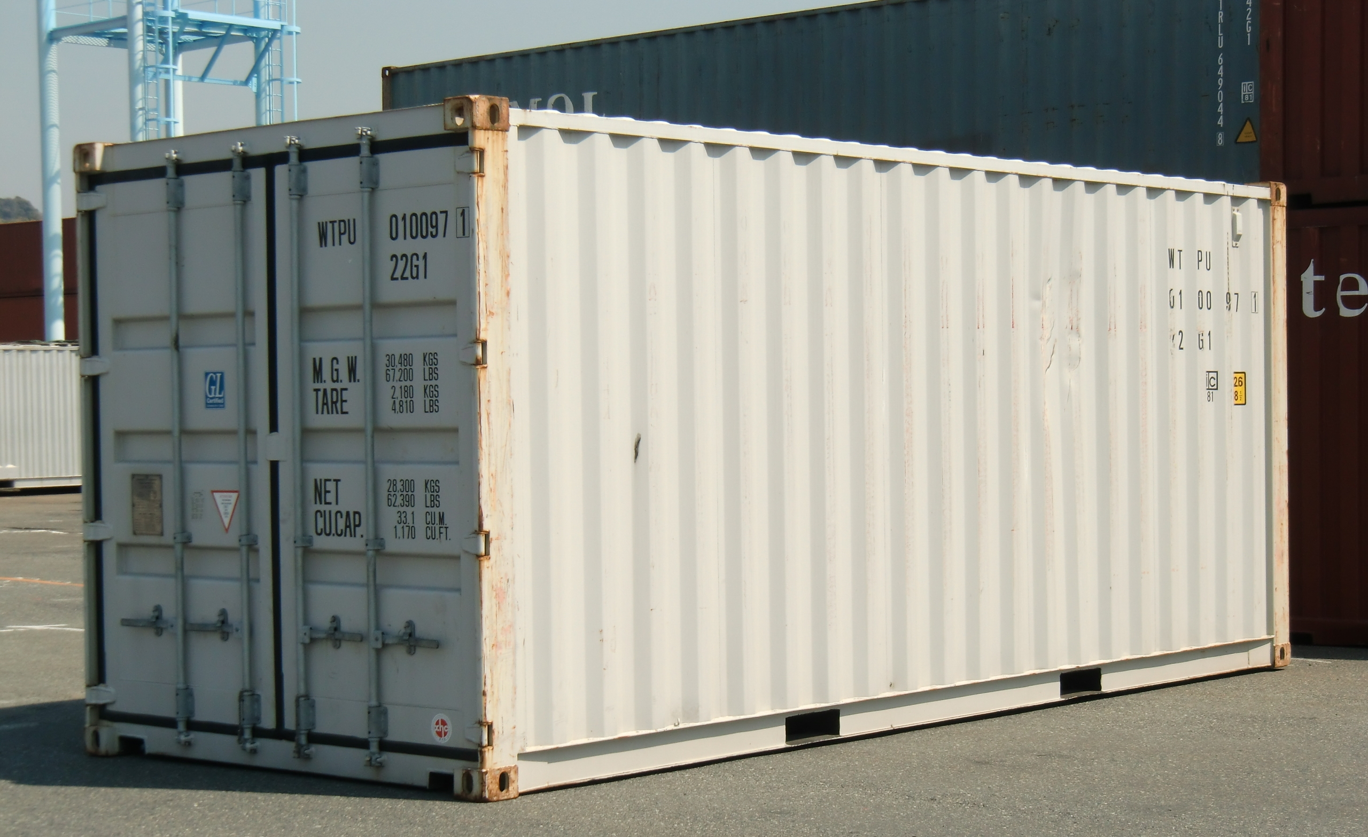


One option to run python programs on Orion is to use Containers
https://sylabs.io/singularity/
Youtube Tutorial:
https://www.youtube.com/watch?v=xQ_vNmxibSg&list=PLhC6xffTaBuUCfP7p07r6ZrrYHc_Fu816&index=5&ab_channel=YngveMoe
Notes:
- Containers contains the necessary programs to run an application
Ensures reproducibility
Share between different platforms
We will use singularity for DAT300.

Slide 35
You must use the singularity container to execute your program.
singularity exec --nv container.sif python example.py
Notes:
The –nv argument is important to use the GPU accelerator.

Slide 36

We have now walked through the ingredients needed to submit your first job on Orion
Next step: Full example

